Slide 1

Exercises
Given the file button.psd create a Web page (HTML + CSS + images) that displays two buttons and a hyperlink:
[OK]
[Cancel]
View More Information
The buttons and the hyperlink should look like in the Photoshop file

Slide 2
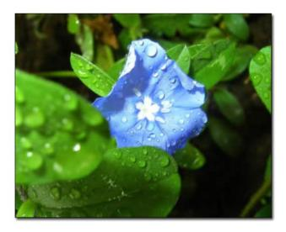

Exercises (2)
Given the file shadow.psd create a Web page (HTML + CSS + images) that displays few images (with different sizes) with a shadow.
Using the file menu-horizontal.psd create a Web page (HTML + CSS + images) that displays a horizontal menu with hyperlinks.

